Slide 1

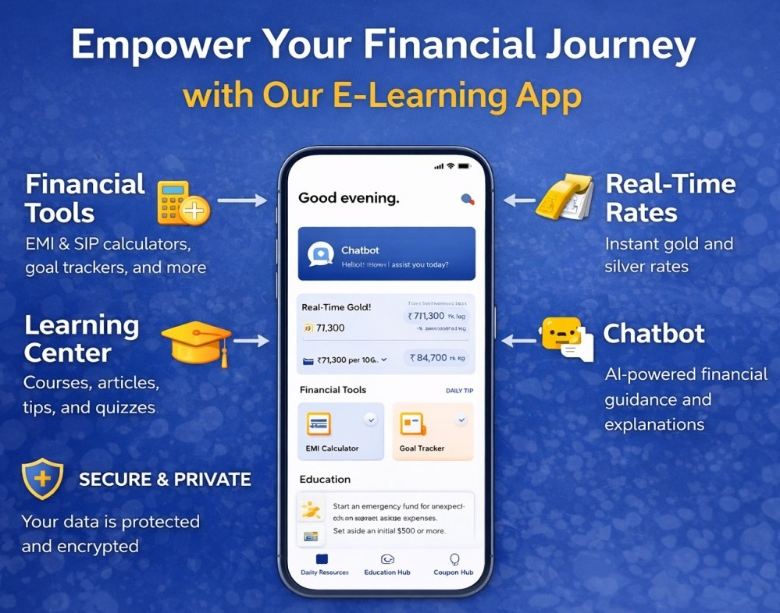
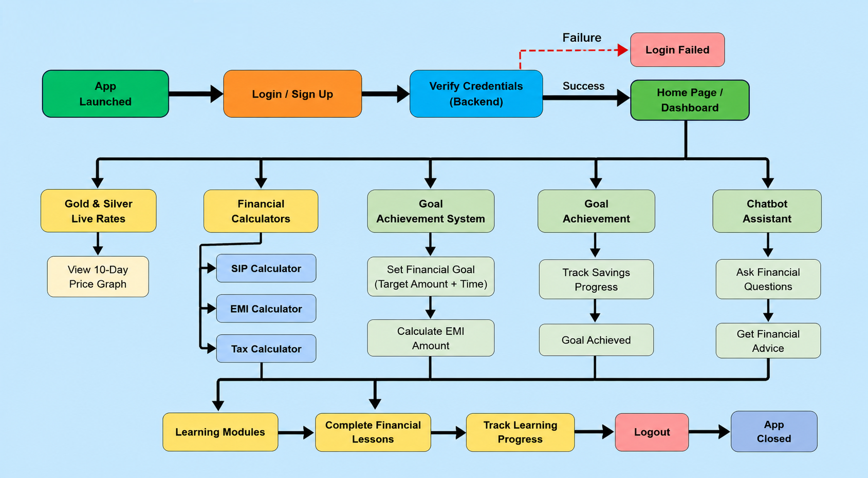
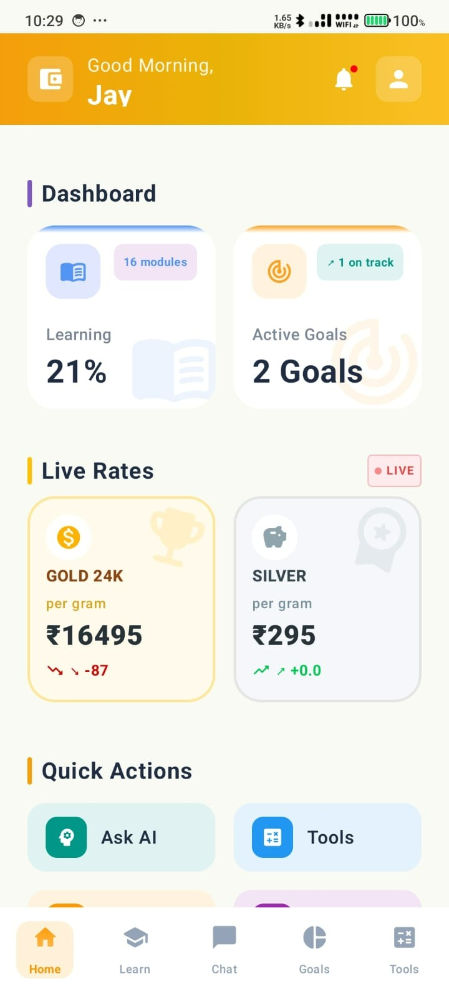
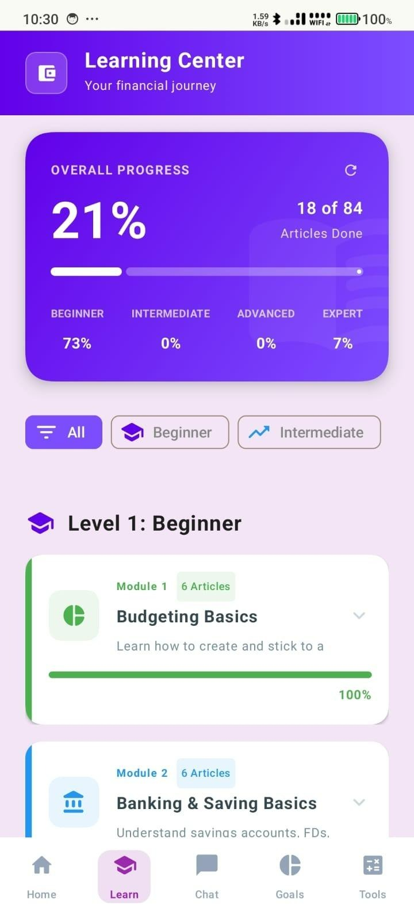
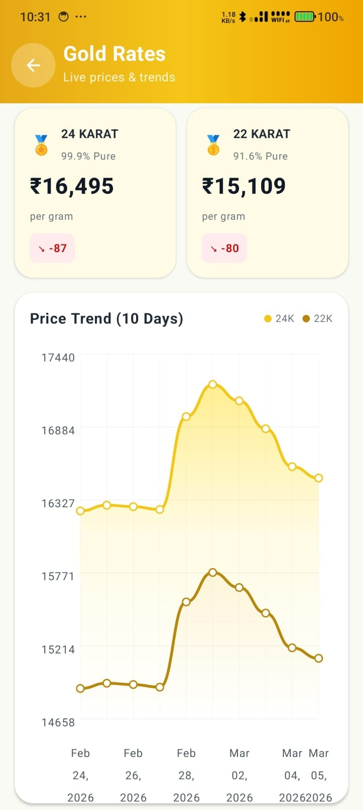
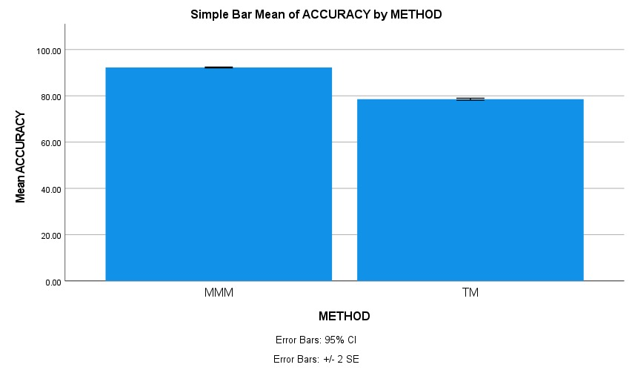
.
Student Name: K.L.V Jayaram
Project Guide: Dr. P. Keren Persis Reg. No: 192210314
Money Mentor – AI-Driven Financial Literacy Application Built with Android and Python
INTRODUCTION
The study investigates the development and performance of Money Mentor, an AI-powered Financial Literacy Application designed to provide secure, accessible, and interactive financial education for users. The system focuses on improving financial awareness and personalized guidance through AI integration and smart financial tools.
Existing financial learning platforms often face challenges such as scattered information, complex financial terminology, and limited practical guidance, which this project aims to address.
The research contributes by developing a secure and user-friendly financial literacy platform that simplifies complex financial concepts, improves financial planning, and provides instant AI-based assistance through modern mobile technologies.
It aims to support the advancement of digital financial education by offering a reliable platform for budgeting, savings, investments, taxation awareness, goal tracking, and informed financial decision-making.
MATERIALS AND METHODS
Fig:1: Money Mentor – Feature Graphics
RESULTS
Fig:5 : Simple Bar Mean Accuracy by MMM and TM
Results showed that the application enhanced user understanding of budgeting, savings, investments, taxation, and financial planning concepts.
Statistical analysis indicated improved user engagement, learning efficiency, and financial decision-making through AI-based recommendations and structured learning modules.
Fig:2 : Dashboard
Fig:3 : Learning Center
Fig:4 : Gold Rate
DISCUSSION AND CONCLUSION
Developed using Kotlin to create a responsive and user-friendly Android application supporting AI chatbot interaction, financial calculators, learning modules, and goal tracking features.
Built using Python for AI processing, secure data handling, user authentication, chatbot responses, financial data storage, and personalized financial guidance.
XAMPP with MySQL was used to manage and store user data, chatbot history, financial records, and learning progress securely and efficiently.
Users experienced personalized financial assistance, smooth navigation, and easier access to financial tools such as EMI, SIP, and tax calculators.
The findings support the adoption of AI-integrated financial literacy applications for accessible financial education, smarter money management, and improved financial awareness among users
BIBLIOGRAPHY
Kumar, R. and Sharma, P., 2022. AI-Based Financial Literacy Systems for Smart Learning and Decision Making. Journal of Financial Technology and Education, 14(3), pp.78–89.
Williams, J. and Carter, M., 2021. Mobile Applications for Personal Finance Management and Financial Awareness. International Journal of Mobile Computing, 11(4), pp.201–214.
Lee, S., Kim, H. and Park, J., 2023. Artificial Intelligence Chatbots in Financial Education Platforms. Journal of Intelligent Information Systems, 20(1), pp.45–59.
Gupta, A. and Verma, S., 2022. Secure Mobile Financial Applications Using AI and Cloud Technologies. International Journal of Computer Applications, 175(9), pp.12–20.
Brown, T. and Wilson, R., 2020. Digital Financial Literacy and User-Centered Learning Platforms. Journal of Digital Innovation, 9(2), pp.133–145.
Singh, V. and Rao, K., 2024. Smart Financial Planning Applications with Real-Time Analytics. International Journal of Data Science and Finance, 6(1), pp.55–67.

